Slide 1
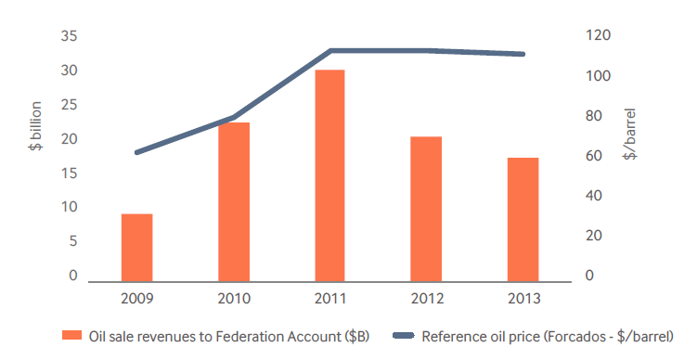
Oil prices versus Federation Account oil sale receipts, 2009-2013

Slide 2
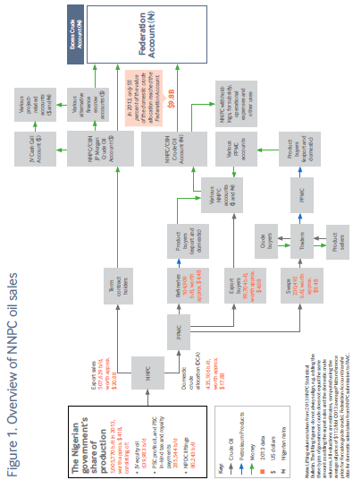

Slide 3
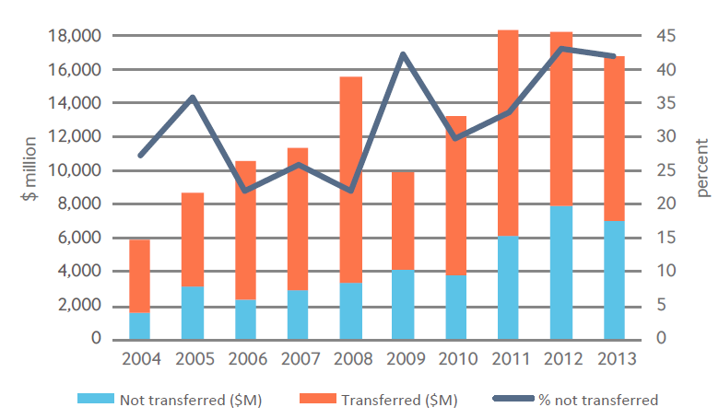
Reported domestic crude sale earnings versus treasury receipts, 2004-2013

Slide 4
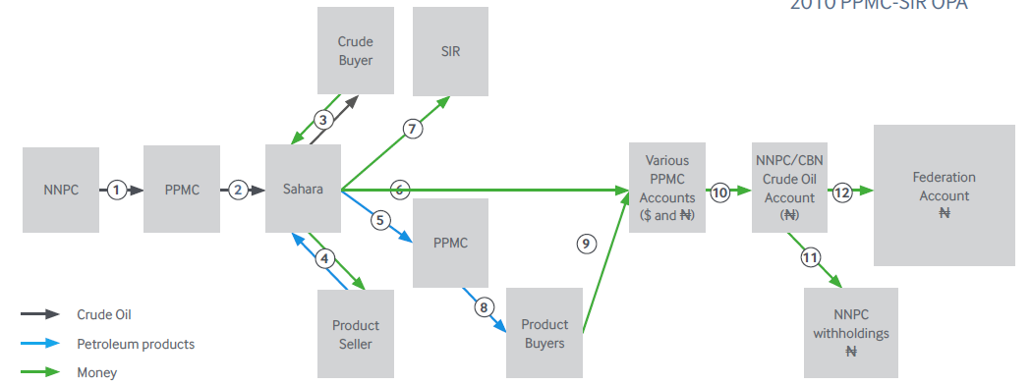
The oil-for-product swap deals
210,000 barrels per day
Oil worth around $7b/yr during Jonathan years
Losses of at least $16 / barrel
Total losses top $400 million per year

Slide 5
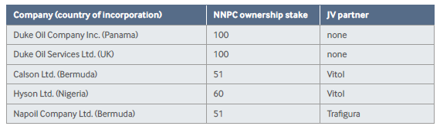
NNPC trading subsidiaries
Nigerian Petroleum Development Company (NPDC)
Oil sold = approx. 80,000 b/d
Oil sale revenues = around $4 billion per year in 2012-2013
Known transfers to the treasury = $0

Slide 6
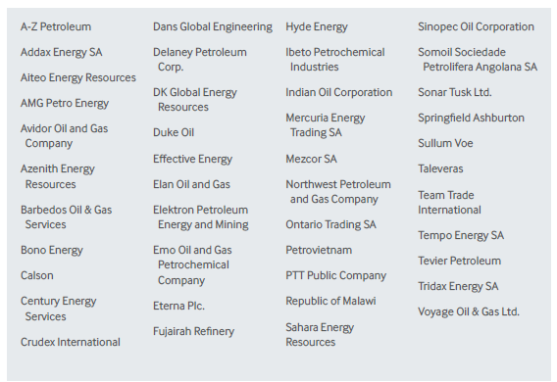
Reported 2014-2015 NNPC term contract holders

Slide 7
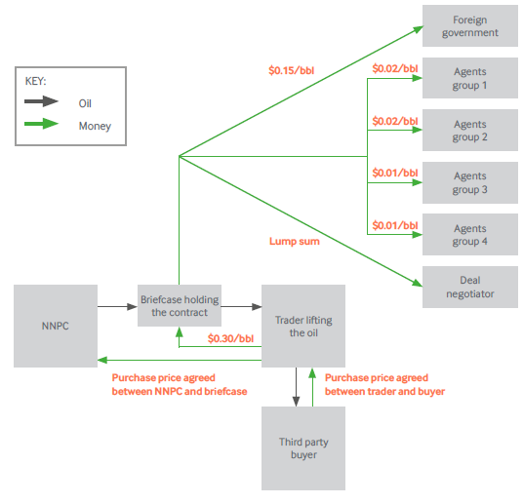

Slide 8
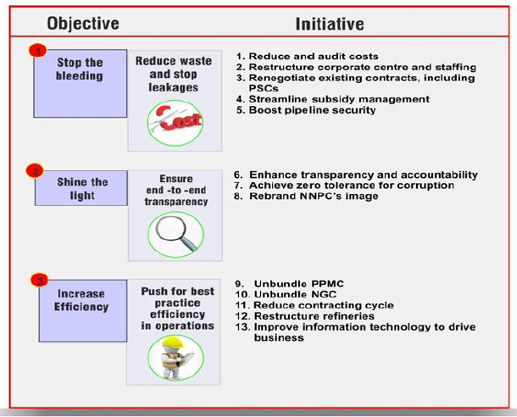
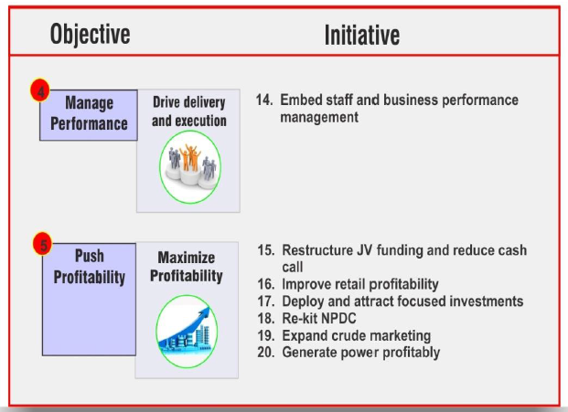

Slide 9
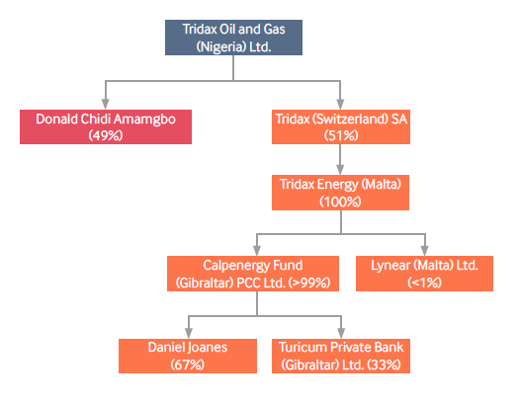
Corporate structure of Tridax Oil and Gas Ltd.

